Slide 1

IBM Capstone Project: The Battle of the Neighborhoods
Open new Indian Restaurant in Toronto,Canada
Authored By-Sourav Roy

Slide 2




The Historical Context
The Indo-Canadian community began to form around the late 19th century, pioneered by men, the great majority of whom were Punjabi Sikhs—primarily from farming backgrounds—with some Punjabi Hindus and Punjabi Muslims, and many of whom were veterans of the British Army.^{[4]} Canada was part of the British Empire, and since India was just as well under British Crown rule, Indians were also British subjects. In 1858, Queen Victoria had proclaimed that, throughout the Empire, the people of India would enjoy "equal privileges with white people without discrimination of colour, creed or race."^{[5]}
In 1897, a contingent of Sikh soldiers participated in the parade to celebrate the Queen's Diamond Jubilee in London, England. On their subsequent journey home, they visited the western coast of Canada, primarily British Columbia, which—because of its very sparse population at the time—the Canadian government wanted to settle in order to prevent a takeover of the territory by the United States.
Throughout history up to the present day, the majority of South Asian Canadians have been of Indian origin. Canada's first South Asian immigrants—all men arrived in Vancouver in 1903.^{[4]} These migrants had heard of Canada from British-Indian troops in Hong Kong, who had travelled through Canada the year prior on their way to celebrate the coronation of Edward VII.^{[4]}
Citation-https://en.wikipedia.org/wiki/Indo-Canadians

Slide 3
In this assignment I will attempt to determine which location is good to open a restaturant in Toronto,Canada
The idea here is to analyze the neighborhoods of Toronto and how many restaurants they already have, how close that neighborhood is from the Central Toronto.And depending on these parameters we will attempt to determine whether it is a good idea to have an Indian Restaurant or not.
Using Nominatim library address values will be converted to Lattitude and Longitude Co-ordinates
Using Foursquare API I will explore the neighbourhood of Toronto
Using Foursquare API venue ratings and likes will be obtained
K-means clustering will be used for clustering
Folium library will be used for visualizing neighbourhoods,venues and clusters
Source of Wikipedia URL for Postal Codes of Toronto - https://en.wikipedia.org/wiki/List_of_postal_codes_of_Canada:_M
Geo Co-ordinates have been sourced from the following CSV file - http://cocl.us/Geospatial_data
Problem Statement

Slide 4
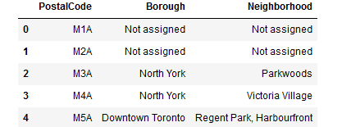
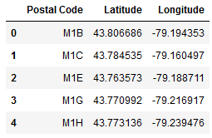
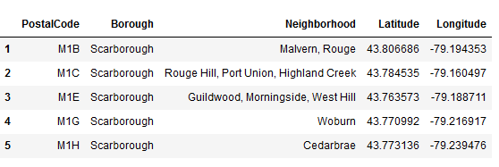
Approaching the solution
We used beautiful soup library to read the Wikipedia source URL mentioned in the slide-3 to read the neighborhood data .
We rinsed and cleansed the data to make the Data look like this
We used Nominatim Library to retrieve the latitude,Longitude information of Toronto
We read the latitude,longitude information of the neighbourhood from the CSV file path mentioned in Slide-3
Finally, we merged these two dataframes and remove duplicate columns to create the complete Dataframe.We also got rid of neighborhoods where we do not have Lattitude and longitude information.

Slide 5
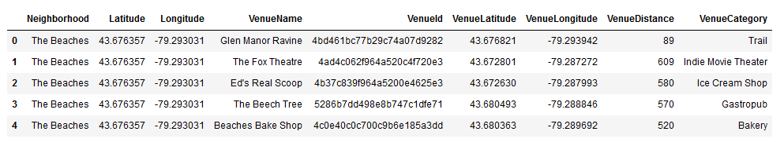
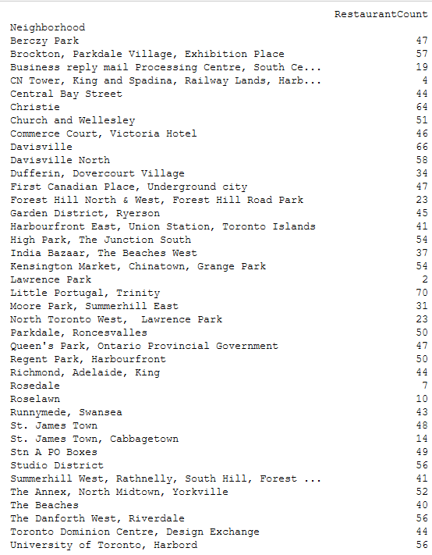
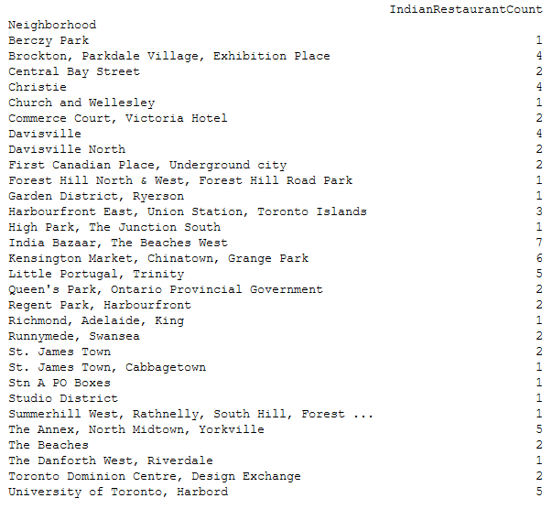
We then used Foursquare API to import all the venues of the neighbourhoods.
We then decided to concentrate only on Restaurants
And decide to have a look how many Indian restaurants we have
Approaching Solution
Continued..

Slide 6
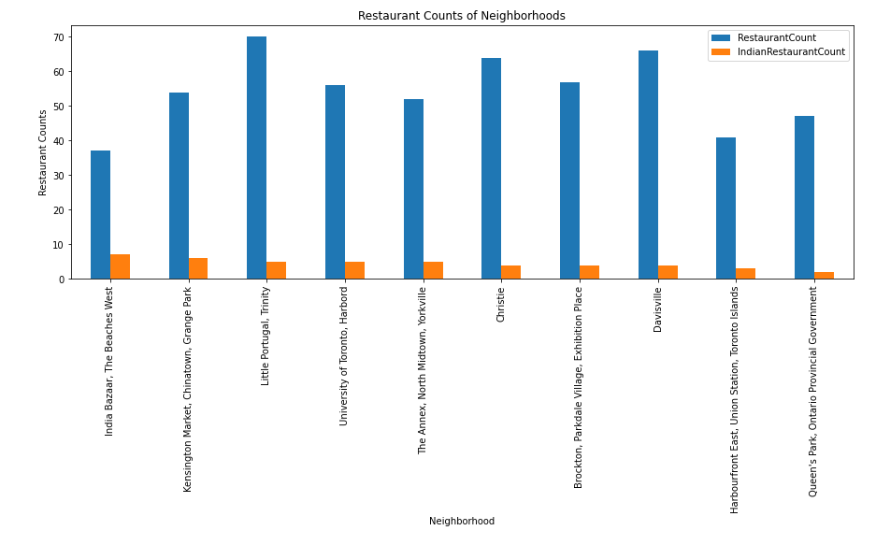
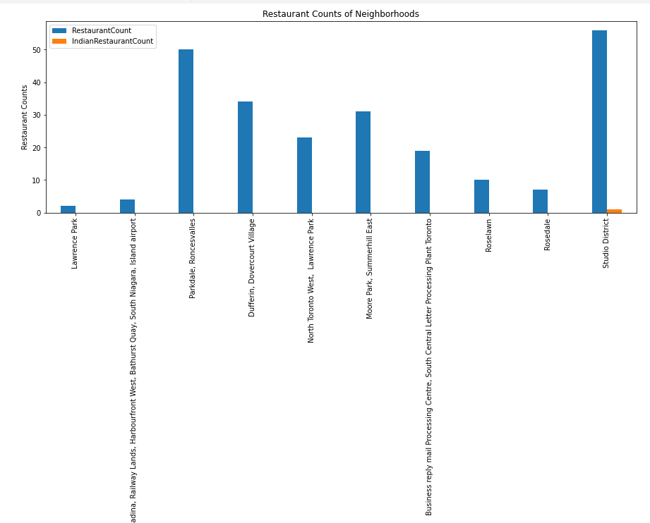
The following graph shows Neighborhoods which have most number of Indian restaurants along with their total number of restaurants
The following chart on the other hand shows neighborhoods which does not have many Indian restaurants.
We immediately have some potential neighborhoods where we can think of setting up an Indian restaurant.
Observation
- Kensington Market Chinatown,Grange Park has very high number of restaurants but relatively low number of Indian restaurants
- Moore Park Summer Hill ,East has very high number of restaurants but no Indian restaurants

Slide 7
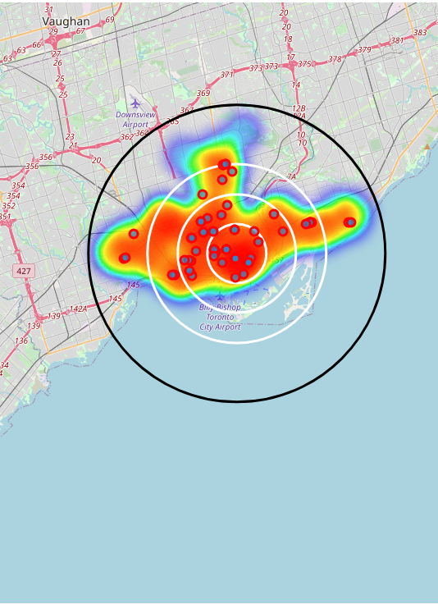
A Heat-map representation of Indian Restaturants
We plotted the neighborhoods having Indian Restaurants on this heatmap using Folium library . The white cirlces represent a 2km,4km and a 6km radius from the central Toronto.

Slide 8
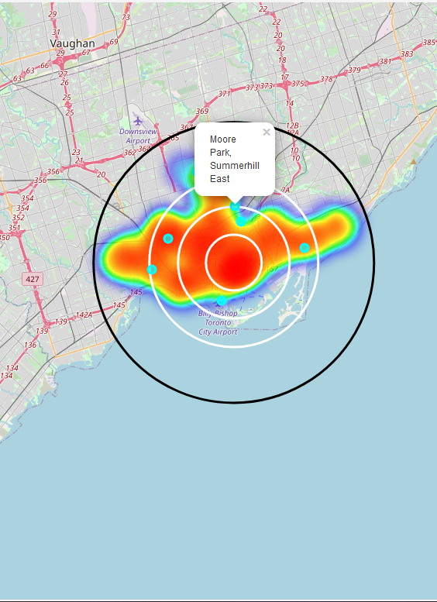
A Heat-map representation of neighbourhoods not having indian restaurants
Rosedale
It is evident that Rosedale and Moore Park are emerging as potential candidate neighborhoods to setup Indian restaurants as they are close to Central Toronto. But we need to analyze further to see if they are indeed the best choices.

Slide 9
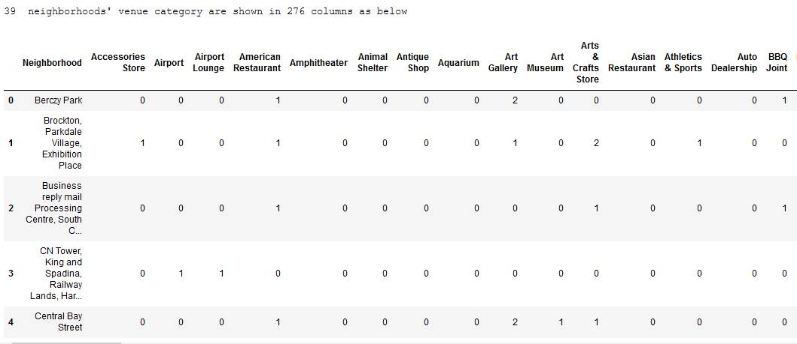
Agglomerative clustering
We used agglomerative clustering to cluster the neighbourhoods
The outlook looks like this

Slide 10
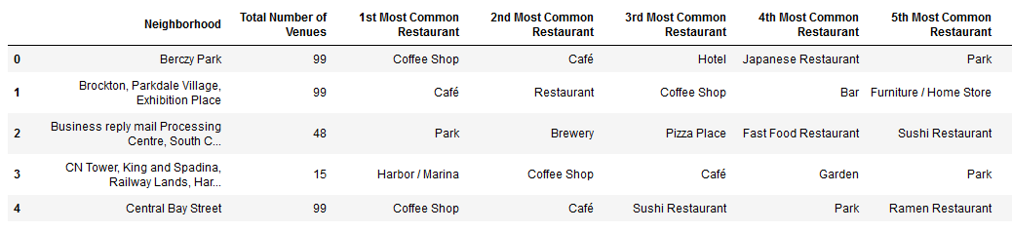
Most Common venues
We then created a new dataframe showcasing neighbourhoods and their most common venues .We are showing upto 10 most common venues per neighbourhood.The dataframe looks like this

Slide 11
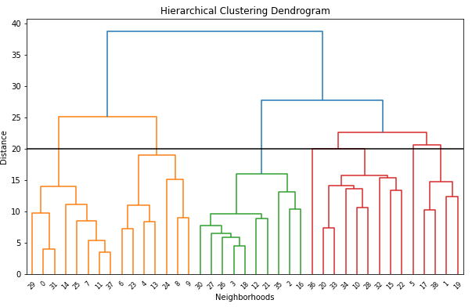
Clustering to find similarities between neighbourhoods
We created a hierarchical clustering Dendogram to determine number of clusters

Slide 12
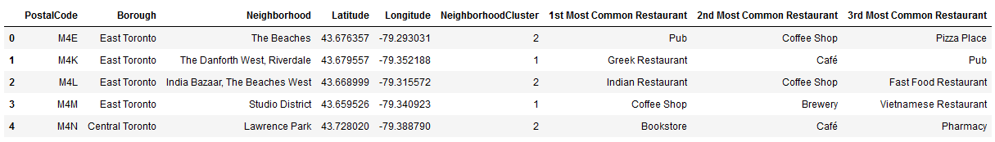
According to the above graph, I decide to separate our neighborhoods into 5 clusters.I will use the hierarchical agglomerative clustering of the sklearn.cluster library to cluster these neighborhoods.¶

Slide 13
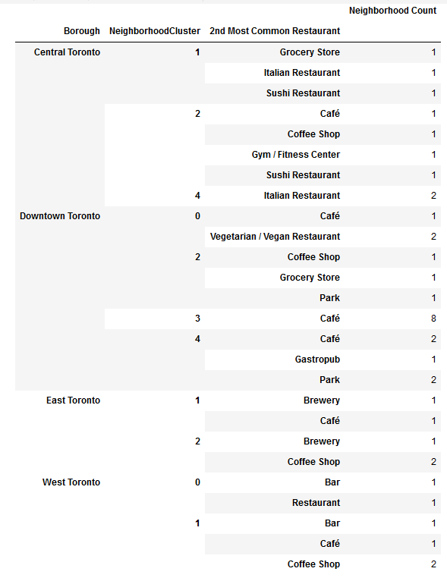
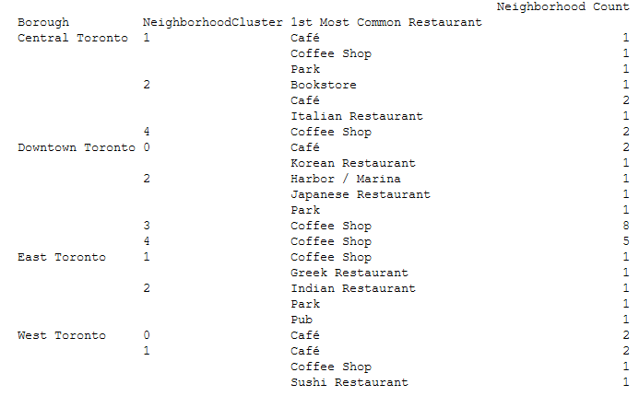
Now we have the borough information along with neighborhood clusters showing most common restaurants

Slide 14
Conclusion
it is fairly evident that except East Toronto all the other sectors are actually a potential candidate borough to setup an Indian Restaurant
-I would choose "RoseDale" as it does not have any Indian Restaurant .More over despite being fairly close to the central Toronto it has only 6 restaurants in total.
-Moore park, Summerhill East is the second neighborhood of choice to open an Indian Restaurant . The neighborhood has 31 restaurants and fairly close to Central Toronto.

